Slide 1
Exposing Phony Reviews: Leveraging Supervised and Unsupervised Learning to Identify Deceptive Feedback

Slide 2





Team Details
Team Name:
P.SRI DIVYA
P.GANESH KUMAR
College: St.peter’s Engineering college
Stream: Computer Science Engineering
Year of graduation:2024
College: St.Peter’s Engineering college
Stream: Computer Science Engineering
Year of graduation: 2024
P.SUSHANTH KUMAR
U.PAVAN
Photo
College: St.Peter’s Engineering College
Stream: computer Science Engineering
Year of graduation:2024
College: St.Peter’s Engineering college
Stream: Computer Science Engineering
Year of graduation:2024
2

Slide 3

Theme
Innovate for Society
Innovate For innovative business solutions, offering or a business model that disrupts the competition in the given industry space
To innovate for society in the realm of detecting fake online reviews using machine learning, we can introduce a comprehensive and adaptive system that combines advanced machine learning techniques with user engagement and education. The system could leverage state-of-the-art natural language processing models. Additionally, it can incorporate a user feedback loop where individuals can report suspicious reviews, contributing to a dynamic dataset for continuous model improvement. To enhance transparency and mitigate bias, the system could provide users with explanations about why a review is flagged as potentially fake, fostering a better understanding of the detection process.

Slide 4
Abstract (Problem Statement)
In the era of the web, a huge amount of information is now flowing over the network.
Since the range of web content covers subjective opinion as well as objective information, it is now common for people to gather information about products and services that they want to buy.
However since a considerable amount of information exists as text-fragments without having any kind of numerical scales, it is hard to classify their evaluation efficiently without reading full text.
Here we will focus on extracting scored ratings from text fragments on the web and suggests various experiments in order to improve the quality of a classifier.

Slide 5
Existing System
Several machine learning-based systems have been developed for the detection of fake online reviews. These systems typically employ supervised learning techniques, utilizing labeled datasets containing both genuine and deceptive reviews.
Many researchers have done experiments to classify the sentiments of the customers on different datasets earlier. Like Turney used a semantic orientation algorithm to classify fake online reviews based on the numbers of positively oriented and negatively oriented phrases in each review.
.

Slide 6
Adv & Dis-adv of Existing System
This type of classification is only done when the classifier has to work on the binary data which is not the case with fake online reviews.
However, from a practical point of view perhaps the most serious problem with SVMs is the high algorithmic complexity and extensive memory requirements of the required quadratic programming in large-scale tasks.
If categorical variable has a category (in test data set), which was not observed in training data set, then model will assign a 0 (zero) probability and will be unable to make a prediction. This is often known as “Zero Frequency”.

Slide 7
Proposed solution
Our proposed system is to apply natural language processing techniques to classify a set of fake online reviews based on the number of stars that each review received.
We develop a maximum entropy classifier to categorize each review from 1-star to 5-stars.
We implement a set of features that we believe to be relevant to the sentiment expressed in fake online reviews and analyze their effect on performance, providing insights into what works and why sentiment categorization can be so difficult.
We analyze how a review’s conformance to a particular language model can be affected by the sentiment of the review.
We experiment with different linguistically motivated models of sentiment expression, again using the results to improve the performance of our classifier

Slide 8
Comparison/Advantages of Proposed Solution with Existing
Good at pattern recognition problems
Data-driven, and performance is high in many problems
End-to-End training: little or no domain knowledge is needed in system construction
Learn of representations: cross-model processing is possible
Gradient-based learning: learning algorithm is simple
Mainly supervised learning methods

Slide 9
Literature Survey
Title | Author | Year | Description
Assisting consumers in detecting fake reviews | Andreas Munzel | 2016 | Current discussions in academia and in the press increase consumers’ awareness of potentially deceptive online reviews.
Manipulation in digital word-of-mouth: A reality check for book reviews | Indranil Bose, Ling Liu | 2011 | Built upon the discretionary accrual-based earnings management framework, our paper develops a discretionary manipulation proxy to study the management of online reviews.

Slide 10
Title | Author | Year | Description
Detection of review spam: A survey | Mohammad ali Tavakoli ,Zahra Heydari | 2015 | These reviews are used increasingly by individuals and organizations to make purchase and business decisions. Unfortunately, driven by the desire for profit or publicity, fraudsters have produced deceptive (spam) reviews.
Incentivized reviews: Promising the moon for a few stars | Deborah Goldring | 2018 | This paper studies the motivations behind incentivized consumer reviews generated via influencer marketing campaigns. Exchange theory is applied as a theoretical framework to analyze, in a qualitative and a quantitative study,

Slide 11
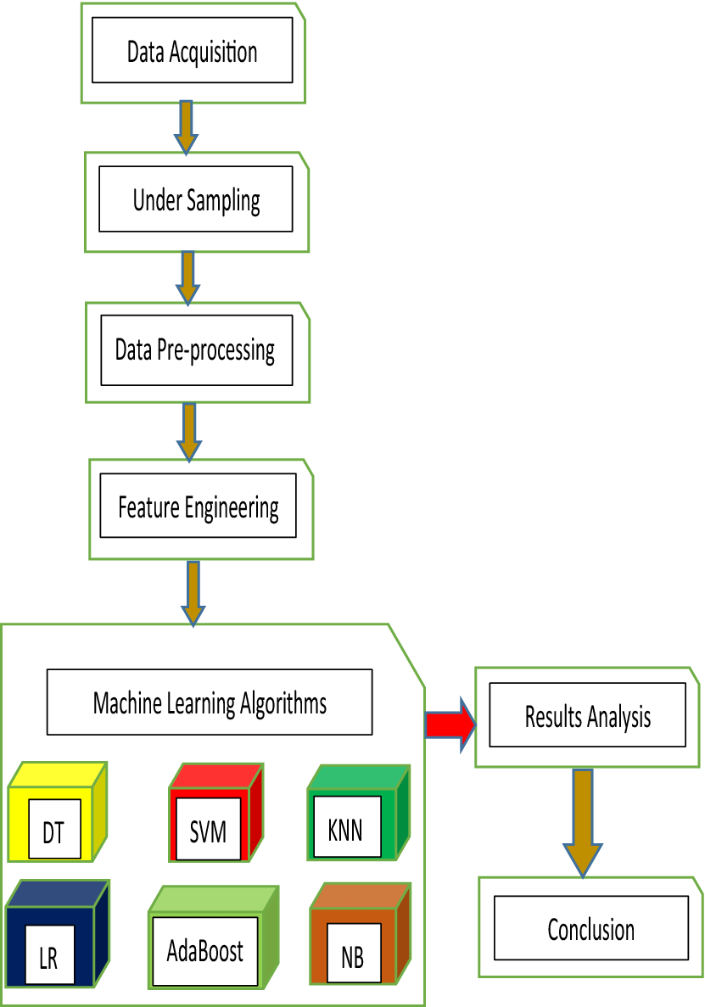
System Design (Overall Project flow Diag)

Slide 12
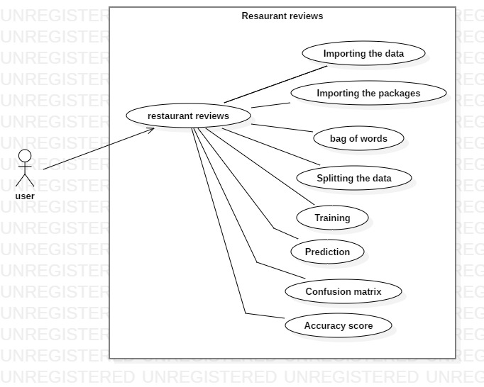
UML Diagrams
Use Case Diagram

Slide 13
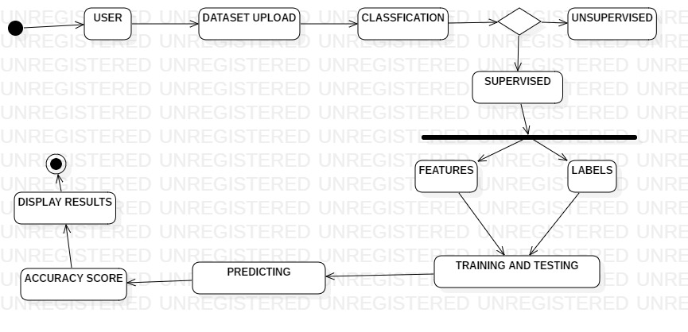
Uml Diagrams
Activity Diagram

Slide 14
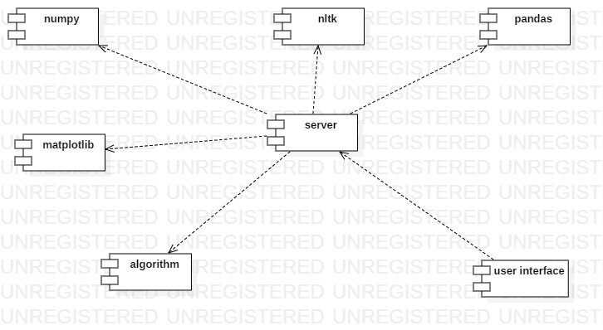
Uml Diagrams
Component Diagram

Slide 15
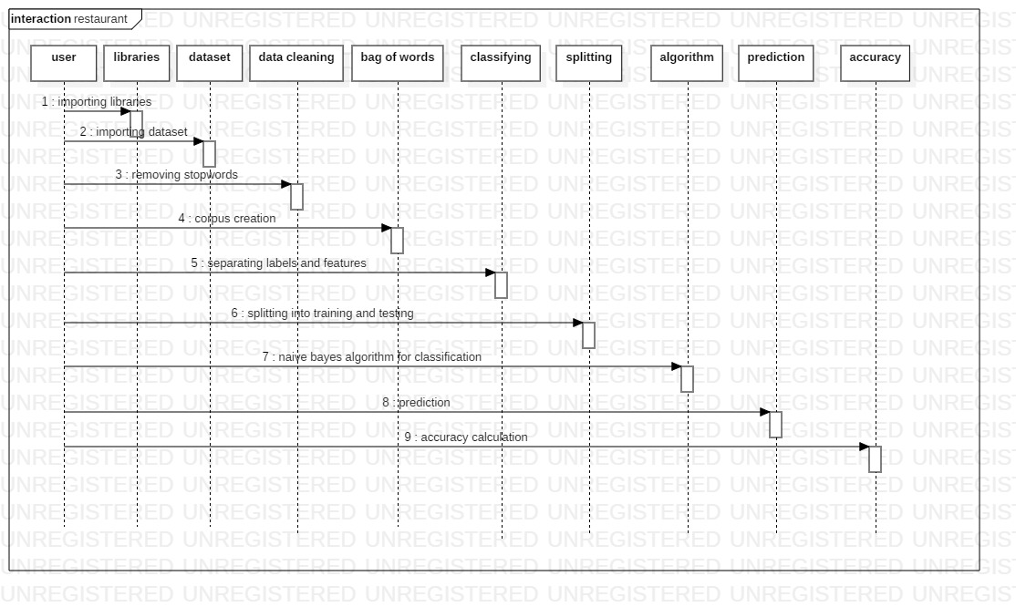
Uml Diagrams
Sequence Diagram

Slide 16
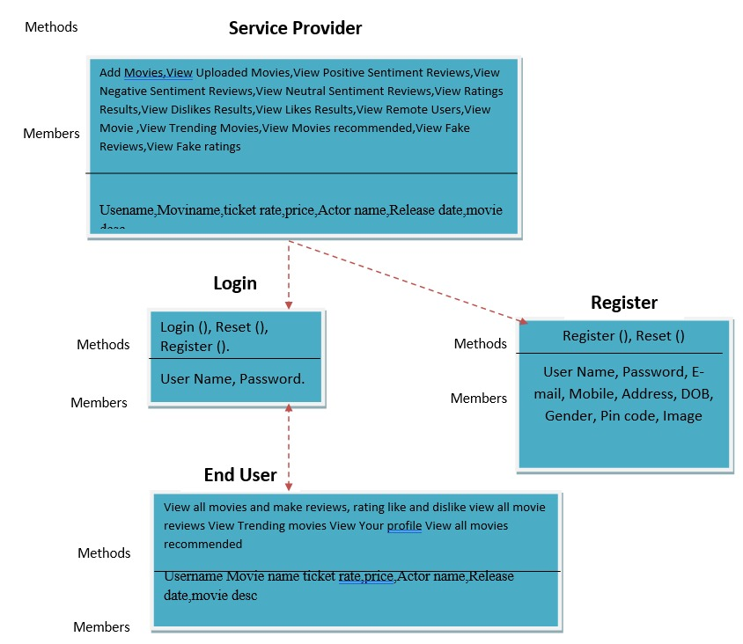
Uml Diagrams
Class Diagram

Slide 17

Queries?

Slide 18


